Slide 1

Learning Constraints with Tensors in Sport Applications
Tom De Bièvre
Notes:
16-12-19

Slide 2

Context
Many real world problems require constraints
Sport scheduling is really complex and laboursome: MLB
  2 leagues
  Each league consists of 3 divisions
  162 games per team per regular season
Could this be automated to lower the amount of work?
DTAI, Department of Computer science
Notes:
16-12-19

Slide 3
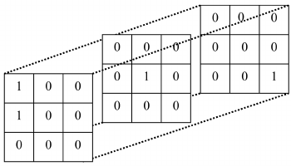
Aim
Use/adapt countOR algorithm with sport scheduling?
  Learning/acquiring constraints
  Making sport scheduling easier
DTAI, Department of Computer science
Notes:
16-12-19

Slide 4

Approach: Literature study
What are sport tournaments? Terminology?
What are sport scheduling constraints? Commonly used?
Mathematical context of constraints
Other algorithms specifically used to generate schedules
Constraint Learning solutions
DTAI, Department of Computer science
Notes:
16-12-19

Slide 5
Approach: Relevant literature
Mohit Kumar, Stefano Teso, and Luc De Raedt. “Automating Personnel Rostering by Learning Constraints Using Tensors”. In: (2018)
Krzysztof Apt. “Principles of Constraint Programming”. In: Principles of Constraint Programming (2003).
Nicolas Beldiceanu and Helmut Simonis. “A Model Seeker : Extracting Global Constraint Models From Positive Examples”
Rasmus V. Rasmussen and Michael A. Trick. “Round robin scheduling – a survey”. In: European Journal of Operational Research188.3 (2008)
Kimmo Nurmi et al. “A framework for scheduling professional sports leagues”. In: AIP Conference Proceedings 1285.May 2014 (2010)
Christian Bessiere. Constraint Propagation, Tech. rep. March. CNRS/University of Montpellier, 2002
DTAI, Department of Computer science
Notes:
16-12-19

Slide 6
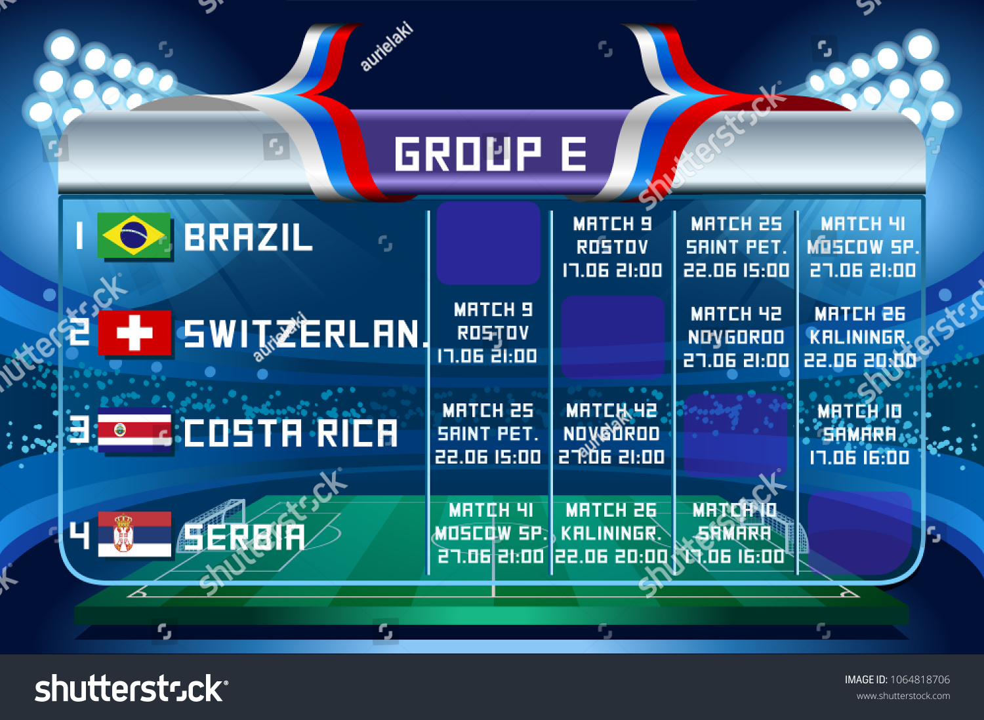
Approach: Research Questions
Representing sport schedules in tensors?
Representing sport constraints using aggregation functions?
What could we learn using countOR as is?
Learning sport constraints from our own tensor data?
DTAI, Department of Computer science
Notes:
16-12-19

Slide 7
Approach: Experimental pipeline
Generate a set of solutions for the SSP
Learn estimated model M from [1,10,25,50] solutions
Generate many samples based on M
Calculate recall and precision based on the samples
DTAI, Department of Computer science
Notes:
16-12-19

Slide 8
Approach: Experimental pipeline
Generate a set of solutions for the SSP
Learn estimated model M from [1,10,25,50] solutions
Generate many samples based on M
Calculate recall and precision based on the samples
DTAI, Department of Computer science
Notes:
16-12-19

Slide 9
Approach: Example constraints
DTAI, Department of Computer science
Notes:
16-12-19

Slide 10
Planning
Check which constraints should already be learned
  Theoretical
  Experimental
Extend the algorithm for the other constraints

